Slide 1
The Health Connection to Climate Change
Birgit Isernhagen, Environmental Professional
Environmental Policy Lead, Ottawa Public Health
November 17, 2022
Notes:
Thank you for the introduction. I’m delighted to be here tonight to talk about the health connection to climate change.
Ottawa public health has been collaborating closely with the City of Ottawa’s Climate Resiliency Unit and the Planning, Real Estate, and Economic Development department on higher level policies like the Climate Resiliency Strategy, Climate Change Master Plan, and the Climate Risk Vulnerability Assessment. I am co-located with the climate group and we are thus sharing and growing our knowledge. Cross-fertilizing LOL

Slide 2
Public Health and Climate Risks in Ontario
Extreme heat
Infectious diseases transmitted by insects, ticks, and rodents
Outdoor air quality (e.g., wildfire smoke)
Water and foodborne illnesses and diseases
Stratospheric ozone depletion
Notes:
The public health and climate risks in Ontario that many agencies agreed upon for our province are the following.
Extreme heat
Vector Borne diseases
Outdoor Air quality
Water and foodborne illnesses and diseases
Stratospheric ozone depletion
The City of Ottawa Climate Risk and Vulnerability Assessment (2021-22) resulted in 40 risks. OPH and the City will work to better understand our communities’ vulnerability to these risks and adaptation strategies to improve their resiliency.
Extreme heat is one of these and this is my focus tonight with you.

Slide 3
Infants and young children​
Older adults (especially living alone)​
Recent immigrants and tourists ​
Pregnant people
People with:
chronic illnesses including mental health conditions
physical impairments​
outdoor occupations
​Those:
without AC or who don’t use it
who are physically active outdoors
that are socially isolated or homeless
Who is most vulnerable to extreme heat?
Notes:
We are all at risk from extreme heat. There are others who are even more at risk. This slide shows you a list of who is most vulnerable to extreme heat.
These include infants, young children, older adults, recent immigrants and tourists, pregnant people, the those that are socially isolated, those with chronic and mental illnesses, have physical impairment, those without AC or don’t use it, people working outdoors, those physically active outdoors.

Slide 4
Notable adverse health impacts associated with extreme heat:
Acute kidney injury
Heatstroke, dehydration, heat exhaustion
Adverse pregnancy outcomes
Worsened sleep patterns
Worsening mental health
Worsening of underlying cardiovascular disease and respiratory disease
Increases in non-accidental and injury-related deaths
Notes:
Notable adverse health impacts associated with extreme heat range depending on your pre-existing conditions, what medications you take, what activity you are doing, etc.
Exposure to extreme heat is associated with acute kidney injury, heatstroke, dehydration, heat exhaustion, adverse pregnancy outcomes, worsened sleep patterns, impacts on mental health, worsening of underlying cardiovascular and respiratory disease, and increases in non-accidental and injury-related deaths.
Exposure to extreme heat also affects health indirectly by restricting people's capacity to work and exercise.
Source: The 2022 report of the Lancet Countdown on health and climate change: health at the mercy of fossil fuels - The Lancet

Slide 5
BC Coroners Report on 2021 Heat Dome Deaths
619 heat-related deaths
98% deaths occurred indoors
67% were older adults
Higher rates among people with chronic diseases (e.g., depression and schizophrenia)
56% lived alone
7% had air conditioning
Most lived in socially or materially deprived neighbourhoods
Notes:
We have all lived through extreme heat in Ottawa. Climate projections for Ottawa say we should expect 4 times as many extreme heat days. So roughly 43 days by 2050.
When we think about extreme heat, I look to last year, to the Heat Dome that established itself over BC (June 25–July 1, 2021). The BC Coroners published a report on Heat Dome deaths.
It was unprecedented with temperatures over 40oC in many parts of the province. Overnight temperatures were also uncharacteristically high, they cooled a bit, but the insides remained hot at over 26oC. Without air conditioning, indoor temperatures remained hazardous throughout this period.
It resulted in 619 deaths where most of the deceased were older adults (67%) with compromised health due to multiple chronic diseases and who lived alone. 98% of deaths occurred indoors and more than half (56%) lived alone. 7% had AC
Heat-related deaths were higher among persons on specific chronic diseases (schizophrenia, substance use disorder, epilepsy, chronic obstructive pulmonary disease, depression, asthma, mood and anxiety disorders, and diabetes)
Not all people experienced the same degree of heat health risks during the extreme heat event. The elderly, persons with chronic health conditions, persons living alone, those with no access to cooling, and those in particular geographic areas were more impacted by the heat. The report highlighted how wider public awareness is needed about heat and targeting community training on how to recognize heat concerns is needed.
Ensuring people have a way of staying cool either inside their residence or elsewhere (i.e., a cooling centre, air conditioned lobby, etc.); and conducting heat-informed checks on older adults, persons with health conditions, those living alone and those with mobility issues to consult them on their on their well-being and support needs.
Source: https://www2.gov.bc.ca/assets/gov/birth-adoption-death-marriage-and-divorce/deaths/coroners-service/death-review-panel/extreme_heat_death_review_panel_report.pdf

Slide 6
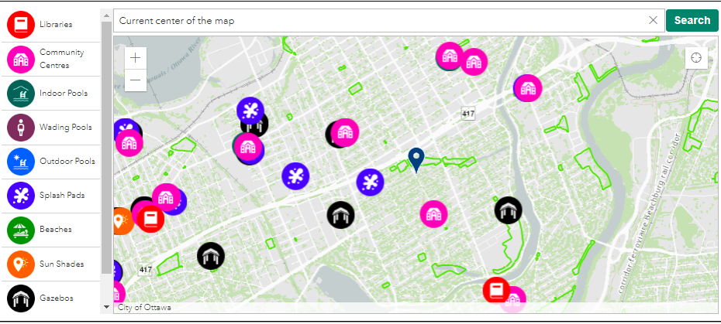
Mitigation and adaptation play a role in protecting ourselves from extreme heat
INSIDE:
- Blackout curtains
- Frequent cool showers and baths
- Soak feet and hands in cool water
- Use air conditioning, fans
- Reach out to others, stay connected
OUTSIDE:
- Dress in light and loose-fitting clothing,
- Wear a hat, drink lots of fluids (limit alcohol)
- Plant trees to shade house
- Look for places to cool (see map)
- Watch out for others who might be suffering
RESOURCES:
- Places to cool off in Ottawa Map
- Beat the heat webpage
- City of Ottawa Urban Heat Island Maps
Notes:
These types of events are going to be more frequent and we need to plan for them.
There are things we can inside and outside our homes that will help mitigate the impact of extreme heat.
Inside you could use things like blackout curtains, AC or fans, and/or take cool water to shower, bathe or just soak your hands and feet.
Outside it’s important to dress appropriately, like with light loose-fitting clothing and a hat. Drinking plenty of fluids is also incredibly important. Before going out, you can always take a look at the new interactive Place to cool off in Ottawa map to help plan out the day. Planting trees to cast shade onto your home is a great long-term solution.
What the Heat Dome made super clear was that watching out for others and calling isolated people would have helped. I put some resources hear on the slide. I invite you to take a look at Ottawa Public Health’s Places to cool of in Ottawa, the Beat the Heat resource page that is in 8 languages, and our urban heat island maps.

Slide 7
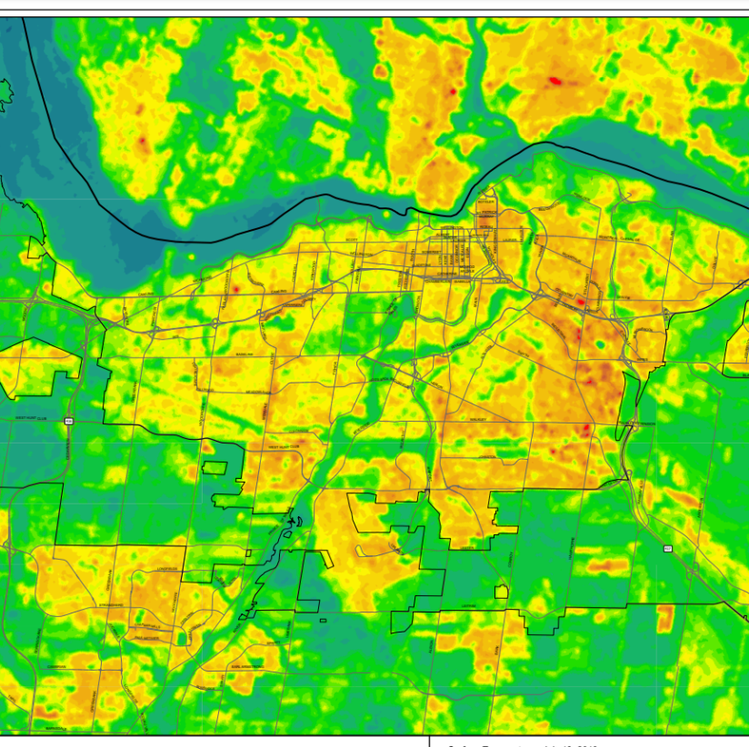
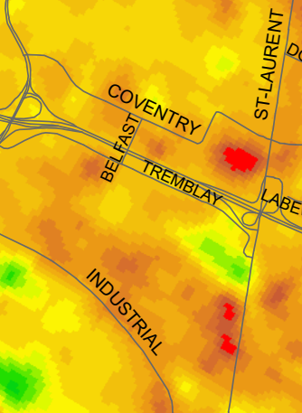
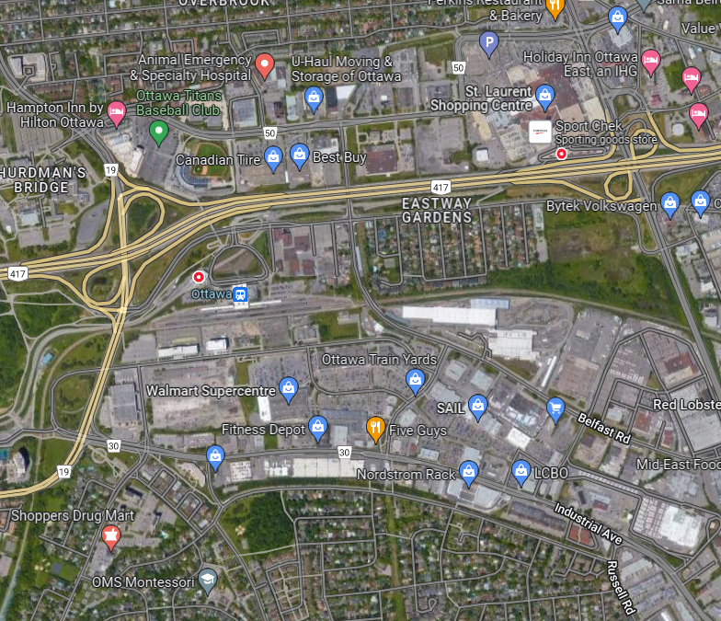
Urban Heat Island Map
Notes:
ECCC helped us get data to publish urban heat island maps for Ottawa for a day of hot weather in July of 2019.
The map shows cool areas include the Ottawa and Rideau Rivers and their tributaries; the Greenbelt; greenspaces, parks, natural spaces; and light-coloured surfaces including buildings with white roofs. Buildings with dark roofs, such as those found on large commercial and institutional buildings, parking lots and artificial turf show up as hot areas that absorb and retain heat.
These maps highlight areas of potential risk created by the urban heat island effect. Additional factors that influence an individual’s risk include access to air conditioning at work, school, home and during commutes, if they work or exercise outdoors, their age, and pre-existing health conditions.
Some areas of the City retain heat more and release it slower resulting in areas that are disproportionally hot. During a heat wave, this would mean that these areas would have little relief from the heat – especially is they are low-income areas with poor access to air conditioning at home, work or during their commute.
My takeaway message to you today is that we each need to take responsibility for ourselves and do what we can to mitigate the impact of extreme heat. We touched on who was most vulnerable earlier, let’s remember to check on them. This could be neighbours or elderly family members in same city or elsewhere in Canada or abroad. Consider their local environment, share information about things that they can do to reduce their risk to the impacts of extreme heat. Ask if they have someone who can look in on them. Maybe you can check on their jurisdiction to see what resources are available to them and share them.

Slide 8
Resources and Contact Info:
Places to cool off in Ottawa: https://www.ottawapublichealth.ca/en/public-health-topics/extreme-heat-and-humidity.aspx
Beat the Heat Webpage: https://www.ottawapublichealth.ca/en/public-health-topics/resources/Documents/Beat-the-Heat_EN.pdf
City of Ottawa Urban Heat Island Maps: https://engage.ottawa.ca/climate-resiliency/news_feed/urban-heat-island
To get involved in climate resiliency:
https://engage.ottawa.ca/climate-resiliency
To learn more: Climatechange@ottawa.ca
Contact information: Birgit.Isernhagen@ottawa.ca
Notes:
This last slide is a list of resources and my contact info at the bottom. In the chat I provided some other resources around the federal and city grant programs for those wanting to begin their own transition and retrofits towards more sustainable living.
Back to you Brenda.
Aside:
From Dr. Tam’s report “The Chief Public Health Officer of Canada’s Report on the State of Public Health in Canada 2022 Mobilizing Public Health Action on Climate Change in Canada” report.pdf (canada.ca):
“When sufficiently resourced, public health systems are well positioned to play an important role in reducing these health risks and impacts. This includes helping communities adapt to a changing climate, protecting those who are vulnerable to climate-sensitive health outcomes, and preparing for climate-related emergencies. Working with other sectors, public health can also promote policies and actions to reduce greenhouse gas emissions that cause global warming in a way that benefits our collective health.

