Slide 1
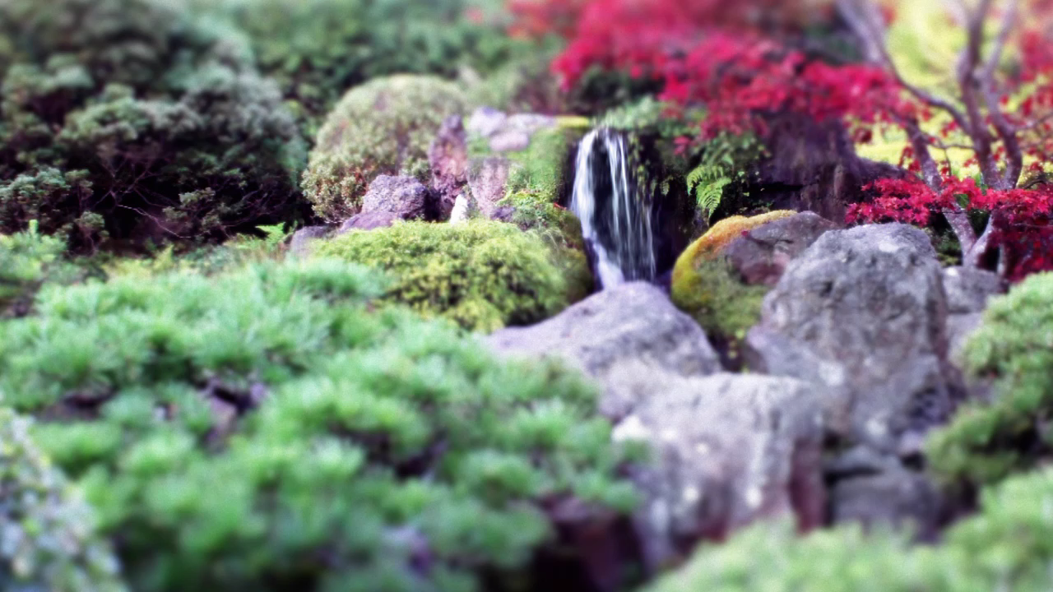
Home landscaping for climate resilience

Slide 2
Rainwater management
Groundcover
Creating Shade
Plantings

Slide 3
Rainwater management
As droughts and flooding become more common, managing rainwater on your property can help deal with both.
A landscape able to absorb and store rainwater prevents runoff into the stormwater system and can make water available in times of drought.

Slide 4
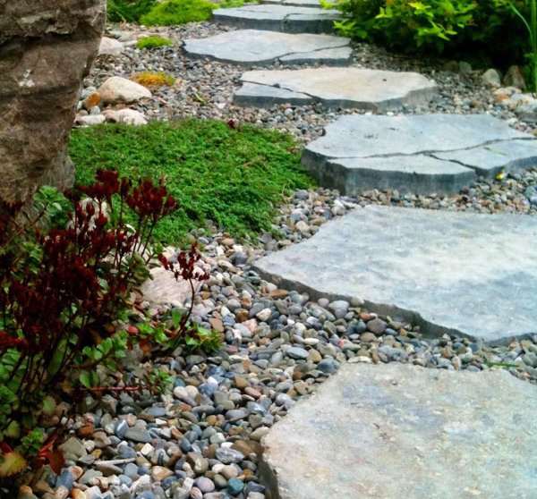
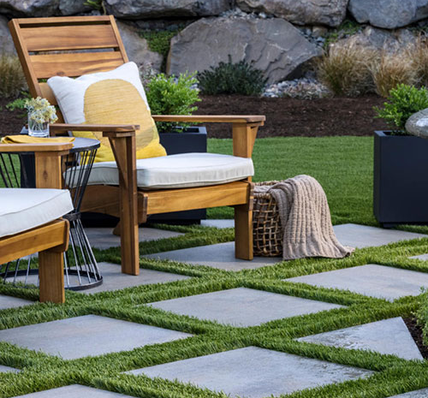
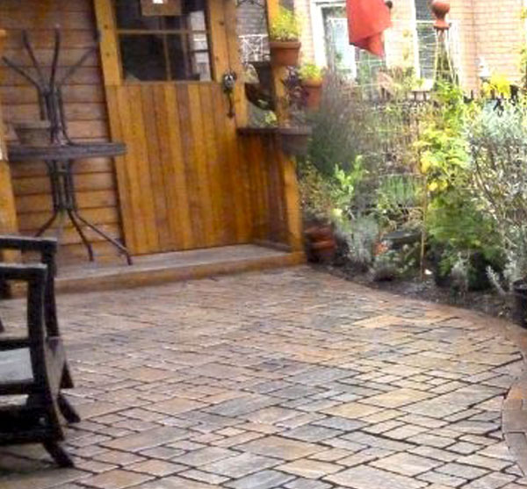
Ways to keep rainwater on site
Permeable Pavement

Slide 5
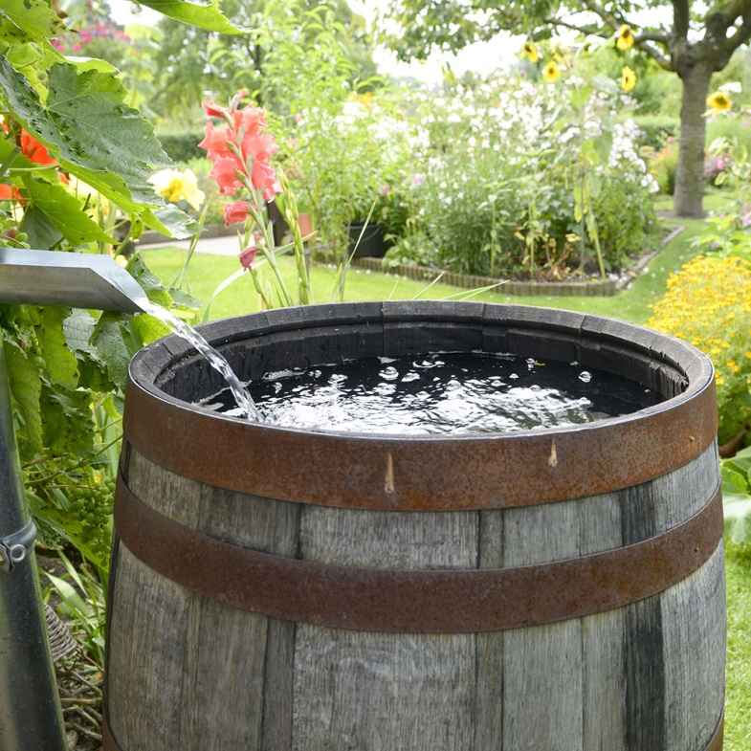
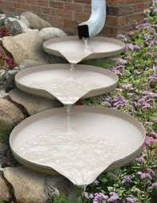
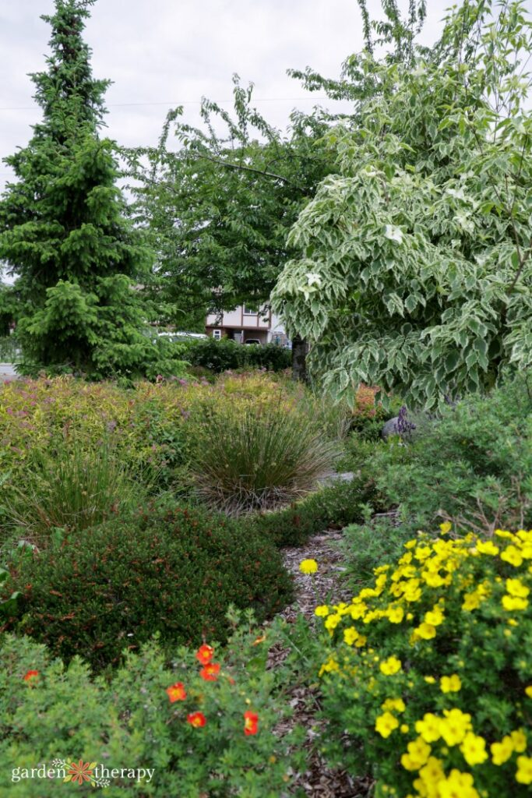
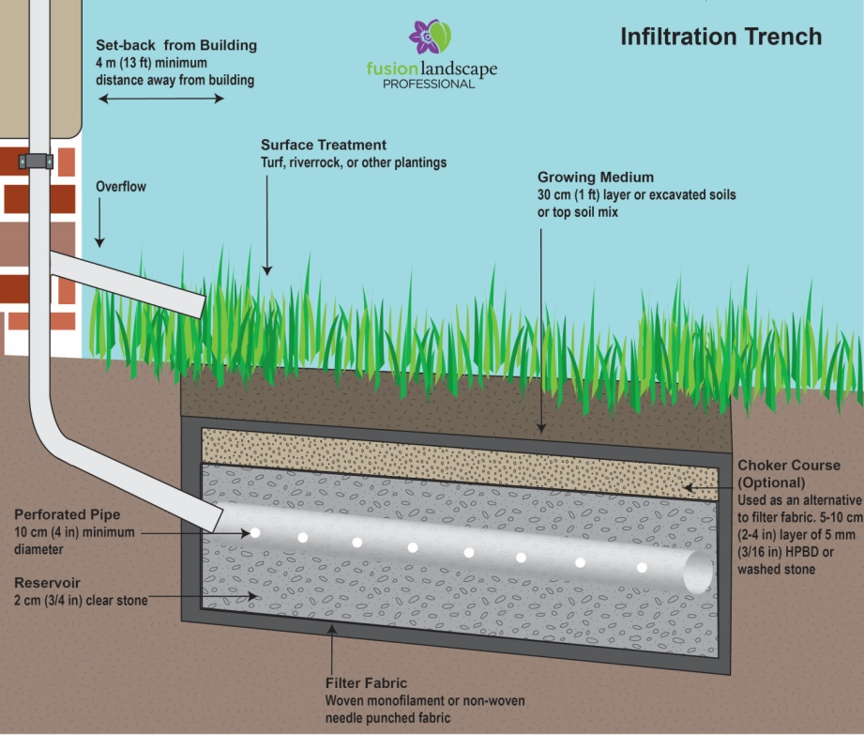
Ways to keep rainwater on site
Redirected downspouts: Install a rain barrel, divert your downspout into the adjacent lawn or garden, plant a rain garden or build an infiltration trench or soakaway pit.

Slide 6
Groundcovers
Whether creeping plants or organic mulches like composted pine or leaf mulch, what covers your ground can help keep soils moist and cool. They can absorb runoff and keep water reserves available in soils during droughts.

Slide 7
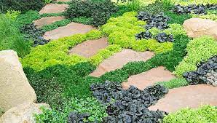
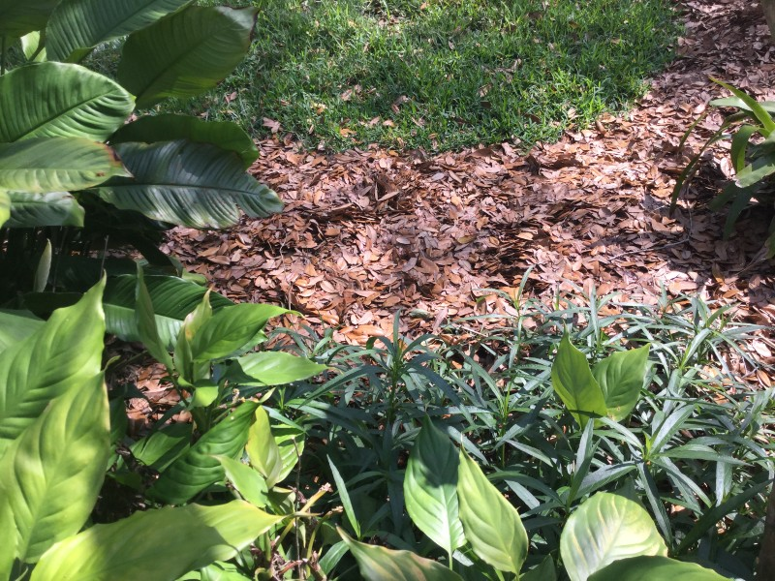
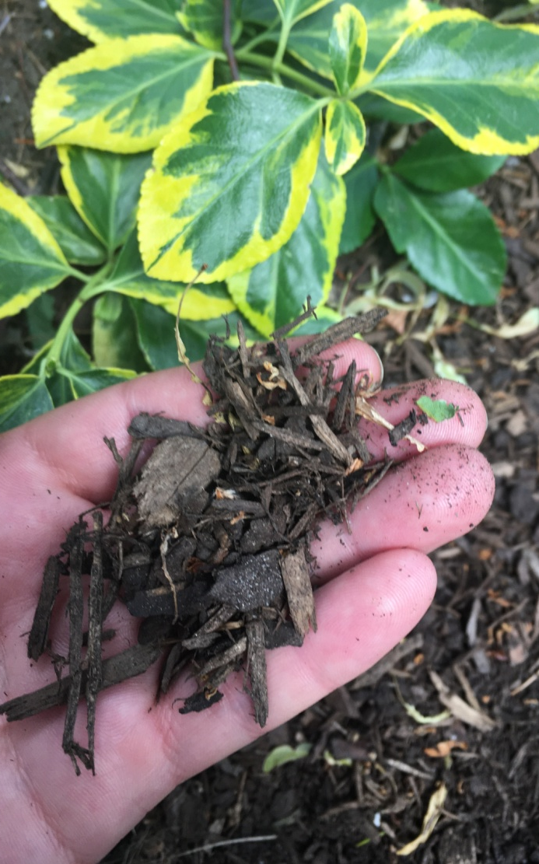
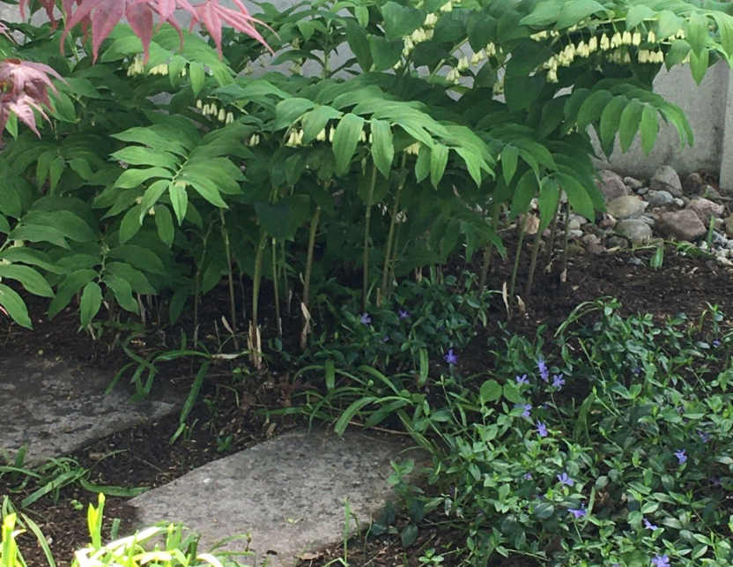
groundcovers
Groundcover plants Composted pine mulch Leaf Mulch

Slide 8
Creating Shade
Finding shady places in the landscape is essential during hot months for people, pets and wildlife.
Creating a shady spot can be an elaborate destination, or a simple canopy or umbrella.

Slide 9

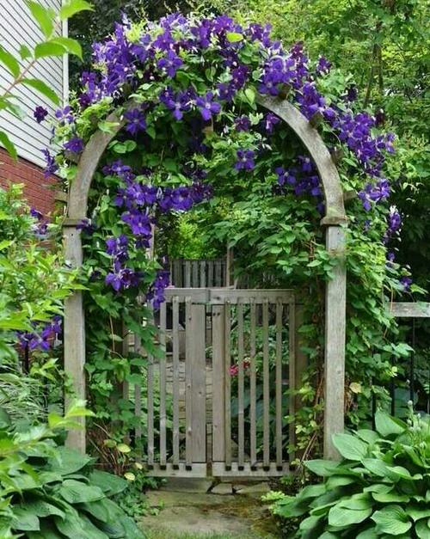
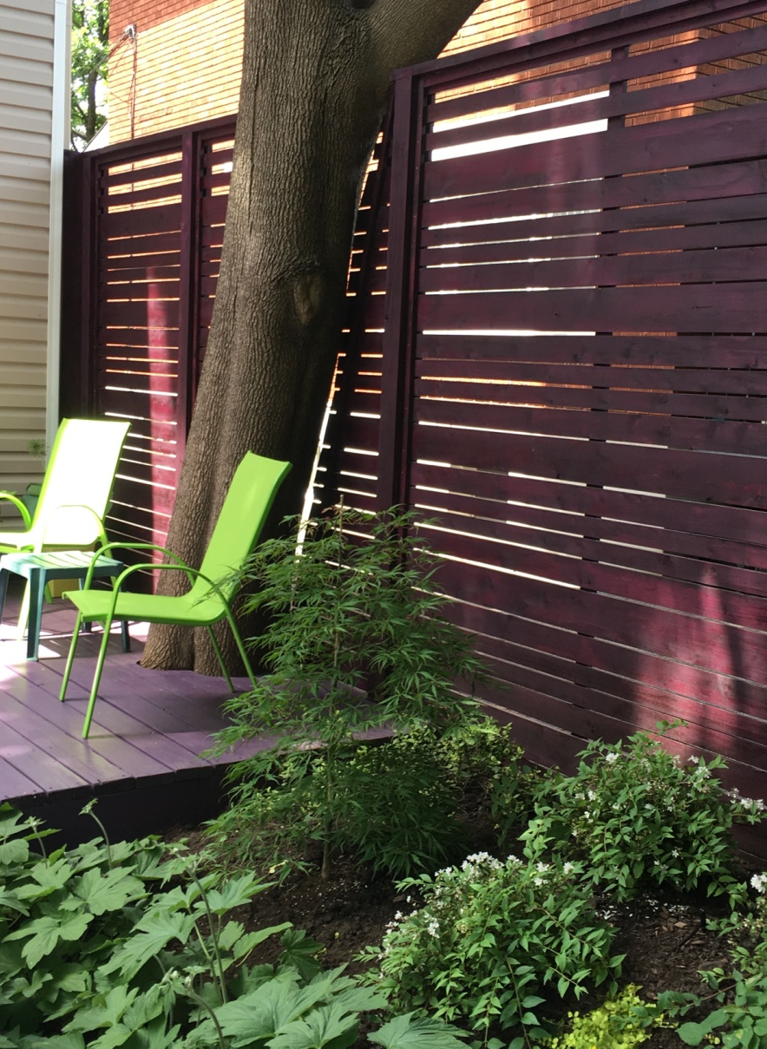
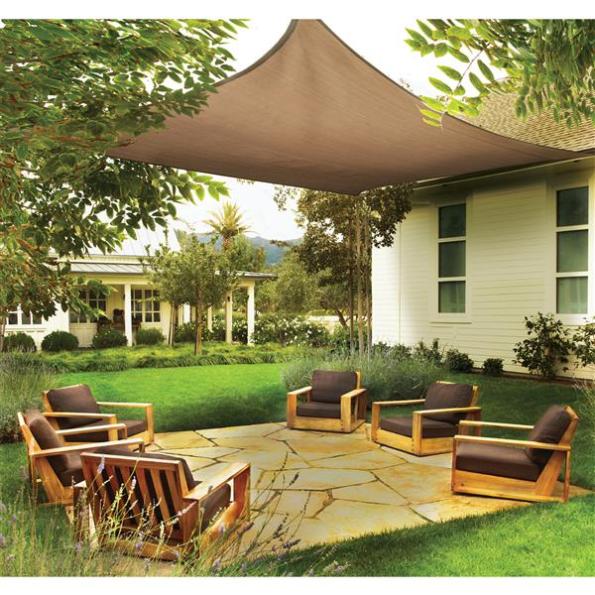
Creating shade

Slide 10
Plantings
Choosing the right plant for the right place is key to any successful landscape. Light, water needs and considerations like snow and salt should be factored in.
Native plants are well adapted to our climate and particularly important for wildlife, but not all may suit tough urban conditions.
Planting a variety of trees, shrubs, evergreens and perennials will give gardens better resilience and environmental benefits.

Slide 11
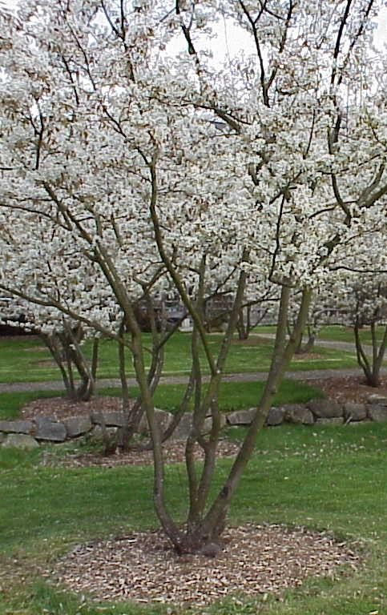
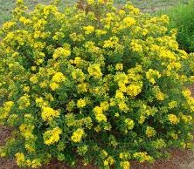
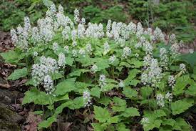
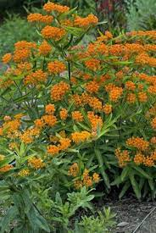
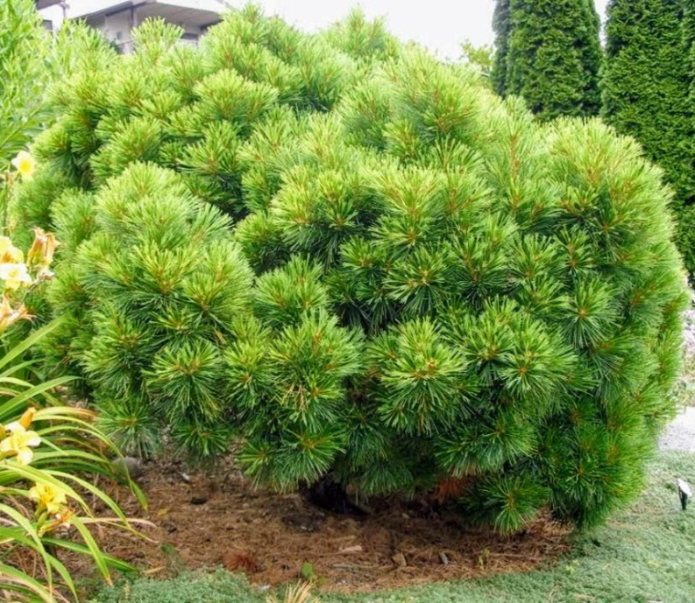
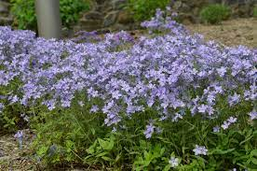
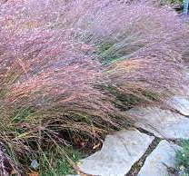
plantings
Clockwise from top left: Serviceberry, Pot’O’Gold, Foamflower, Butterfly Weed, Little Bluestem Grass, Horsford Dwarf White Pine, Woodland Phlox

Slide 12
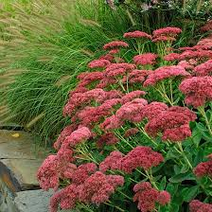
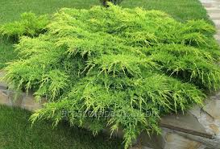
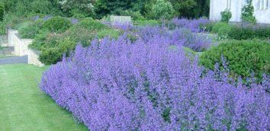
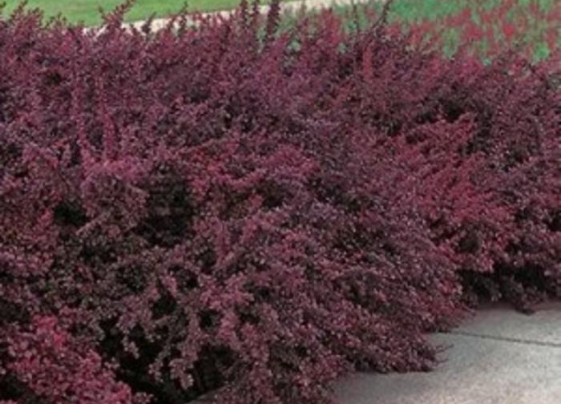
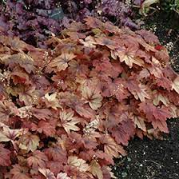
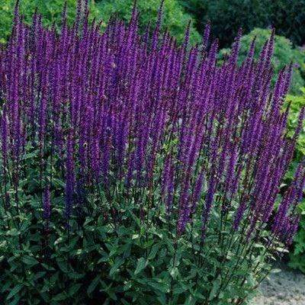
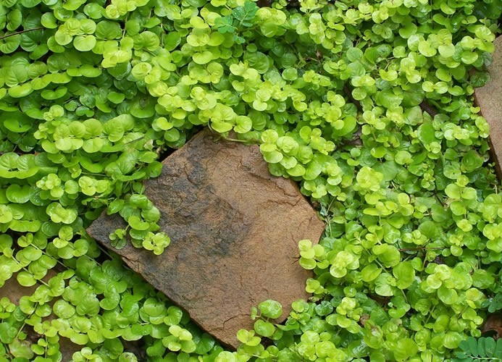
Plantings
Clockwise from top left: Fall Stonecrop, Gold Star Juniper, Catmint, Creeping Jenny, Perennial Sage, Foamy Bells, Barberry

Slide 13
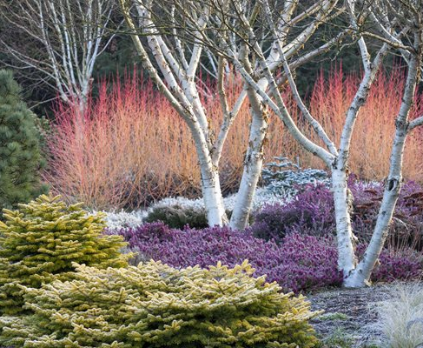
Resources:
ottawa.ca/rain
missouribotanicalgarden.org/plantfinder
landscapeontario.com/fusion-landscaping
cwf-fcf.org/en/explore/gardening-for-wildlife

