Slide 1
Centretown & Glebe Climate Resilience Panel Discussion
November 17, 2022
Towards a Resilient and
Functioning Urban Forest
Andy Kenney

Slide 2
Urban Forest Benefits (functions)
Micro-climate Amelioration
Carbon Sequestration
Improved Air Quality
Storm-water Attenuation
Energy Conservation
Noise Attenuation
Wildlife Habitat
Physical & Psychological Well-being
Property Value & Aesthetics
etc.
Notes:
“Functioning urban forest” = urban forest that provides services to society and the broader environment
These are not mutually exclusive so we needn’t select one or two as a focus for our stewardship.
This presentation won‘t discuss these in any detail but we should keep in mind that sustaining or enhancing these benefits should be the goal of any stewardship plan.

Slide 3
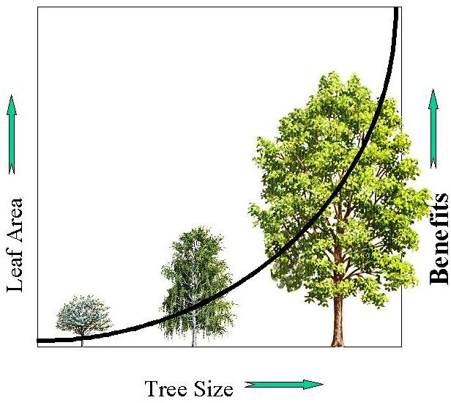
Benefits increase with leaf area
Leaf area increases exponentially with tree size
“Big” trees are important

Slide 4
Urban Forest Stressors
Climate change - extreme weather events
Wind
Ice
Drought
Flood
Pests and Diseases – invasives
Infrastructure
Competition for space above and below ground
The construction process

Slide 5
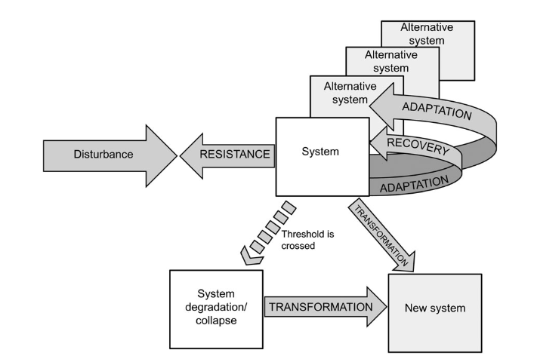
Resilience
Resistance
Recovery
Adaptation
Transformation
Fuller, L. and Quine, C.P. 2016. Resilience and tree health: a basis for implementation in sustainable forest management. Forestry 89:7-19.
https://academic.oup.com/forestry/article/89/1/7/2465813?login=false

Slide 6
Leaf Area and Resiliency
Components of Resiliency
Species diversity
Age diversity
Structure & Health
Growing environment
Stewardship

Slide 7
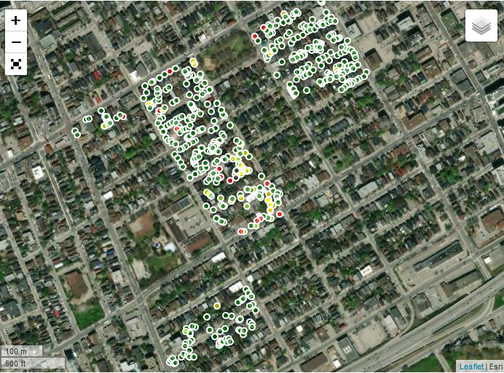

Slide 8
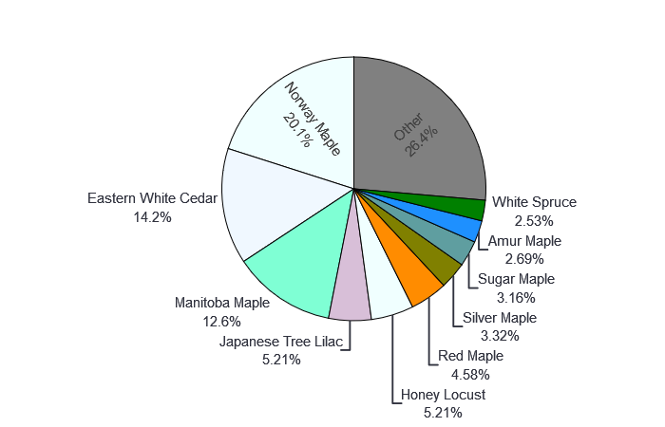
Resiliency and Stewardship
Species Diversity

Slide 9
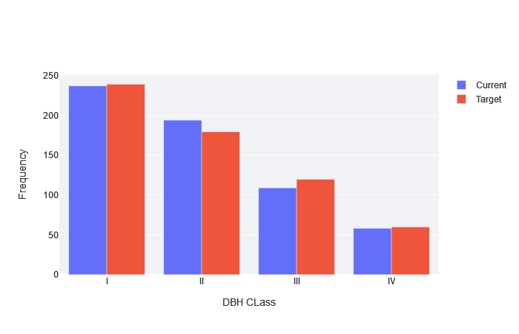
Resiliency and Stewardship
Age Diversity

Slide 10
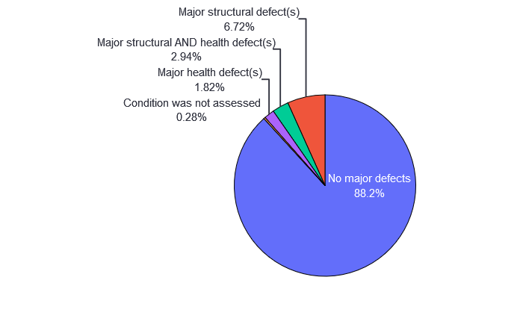
Resiliency and Stewardship
Health and Structure

Slide 11
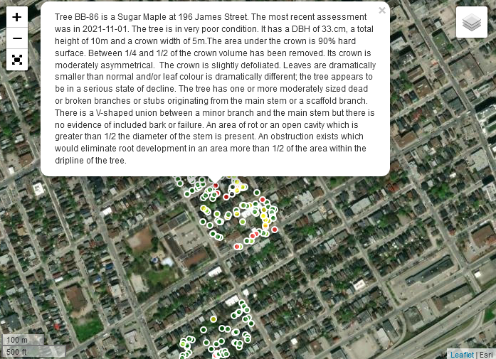

Slide 12
Resiliency Action
Become aware of the state of the urban forest:
on your property, in your neighbourhood, in your city
Neighbourwoods
Inventory
C&I
Stewardship Plan
Plant a tree, steward a tree!!

