Slide 1
Climate resiliency are we ready?
Centretown community association
& glebe community association
Toon Dreessen, OAA, FRAIC
Notes:
Hello thanks for having me here!

Slide 2

It is all connected
Notes:
It is important to start off by realizing everything is connected. We can’t talk about one thing without connecting the dots to other impacts.

Slide 3
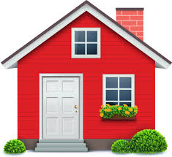
DESIGN
WELL-BEING
EQUITY
SUSTAINABILTY
Notes:
How we choose to design our homes, our communities and cities is itself interconnected: our homes don’t exist in isolation; the affect and are affected by their community.
If we want to achieve social equity, social justice, and create places that are welcoming, inclusive and accessible, we can’t do that without considering the impact of design on our daily lives
Our sense of wellbeing is intimately linked to what we design, how we live, our sense of social connectedness and how we feel about our surroundings. Our built environment affects our mental and physical health, our sense of belonging and our sense of community.
Our approach to sustainability drives all these factors, and is driven by them, to help us achieve our goals. Sustainability outcomes aren’t in isolation; if they are, they’re greenwashing.
We can’t do one of these well without considering the others.

Slide 4
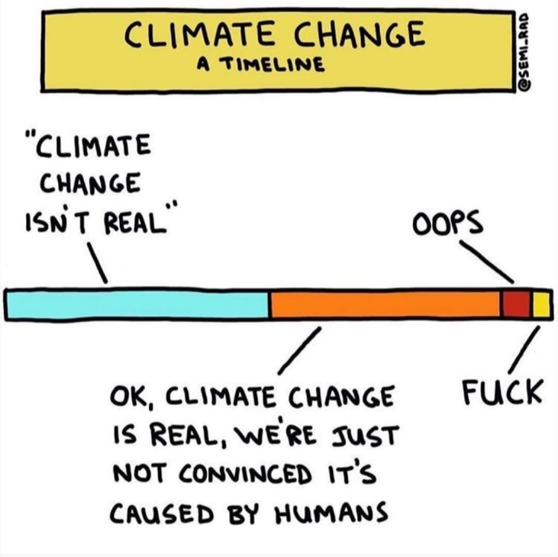


Notes:
You may have seen me share this infographic before. Arguably, we’re not alone on this chart. We’ve spent far to long debating if climate change is real and failing to take meaningful action. I know where we are and how pressing it is that we take action.
But sometimes it feels hopeless. Whether its an election outcome or a new apartment building around the corner, these are political decisions. So the number one thing we need to do is to become politically engaged. Every decision on the built environment is political at some level: planning applications, zoning bylaws, official plans, siting and location of new community infrastructure – these are all political decisions that affect how we get the community we strive for.
So the old adage is true: yes we need to think about the big global issues, but we also need to take local action. What can we do, today, tomorrow and next week, to make our homes and communities resilient? In the absence of

Slide 5
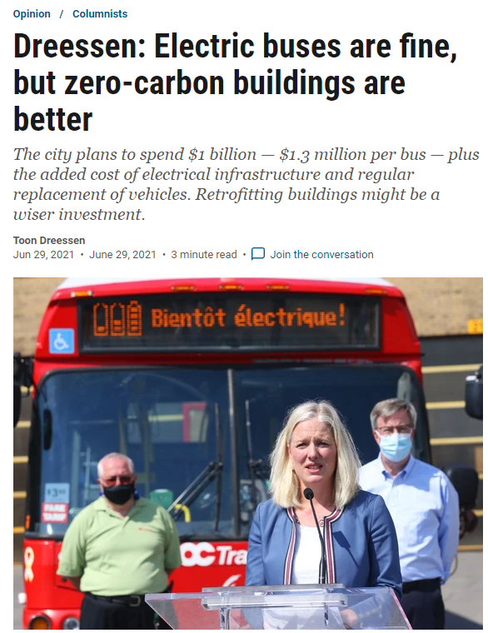
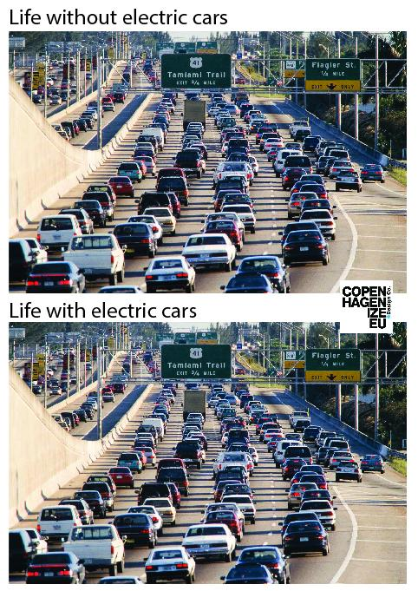
Electrify
Notes:
Yes, we should invest in electric buses. That’s good. And electric cars are also fine, in that both are better than fossil fuel burning vehicles. And yes our grid in Ontario is pretty clean, and cleaner than it was a generation ago.
But an electric bus only lasts about a decade. And an EV about the same. So we commit ourselves to billions of dollars in replacement costs for short lived equipment while our buildings continue to crumble and we miss an opportunity to invest in buildings that can sit there for decades, quietly not moving and not using energy.
And while you can sometimes get rebates for buying an electric car that needs an expensive infrastructure to charge and maintain, you never see rebates for electric bikes that need far less infrastructure or maintenance and have a longer life span, are better for the economy and better for our health and better for our economy.

Slide 6
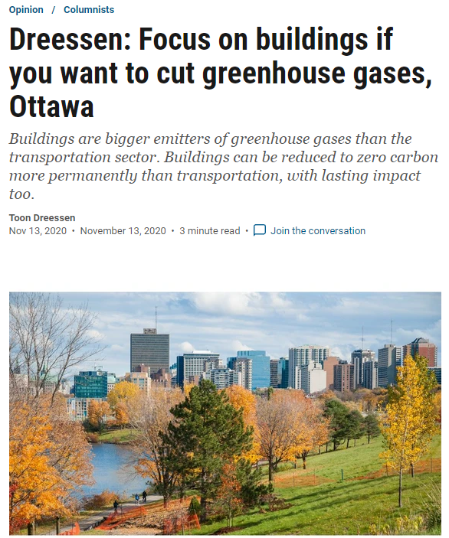
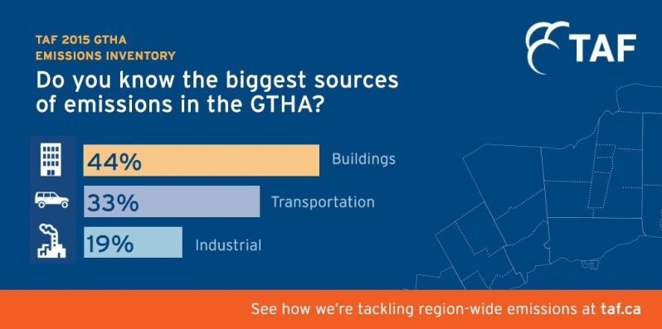
Electrify
Notes:
We need to invest in electrifying our buildings if we want to make real strides on achieving our goals.
But just converting your gas furnace to an electric furnace isn’t going to do it.
Remember when I said it is all connected? Electric heat is very efficient but needs a better building to make it viable: better insulation, better windows, more efficient air movement to keep us healthy.

Slide 7

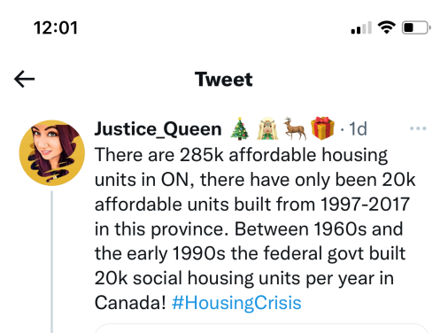
Path to zero
Notes:
The key is not just to electrify your home’s energy needs but to go back to the 3 Rs
To start, we need to reduce our energy need: to make a more efficient building that needs less energy: that means more insulation, a better envelope, more efficient lighting, smaller spaces that take less energy to heat and cool and located in a community where you can shop, work or otherwise meet your daily needs by walking, biking or transit.
We also need to reuse: to adapt our buildings instead of tearing them down to build new ones. Reuse our infrastructure by gently intensifying instead of building more suburbs that take away greenspace. We need to reuse energy by conserving it and extracting waste heat from exhaust air or water so that we waste less. This chart is the age of public housing owned by the Toronto Community Housing agency and likely closely resembles many cities: we invested enormously in the 60s and 70s and very little since.
Recycle: we need to use energy from recyclable sources: power our buildings with solar or wind or other renewables and low or no waste sources; use ground source district heating and cooling systems and air source heat pumps to take advantage of natural and regenerative systems. We need to look at renewable building materials: concrete buildings are great for high rises but consume enormous amounts of energy to create the concrete. A mass timber building is made of small trees, sequesters carbon instead of using it. Renewable building materials that are good for our health, and good for our planet, can also be recycled when the building is at the end of its life or needs to be modified.

Slide 8
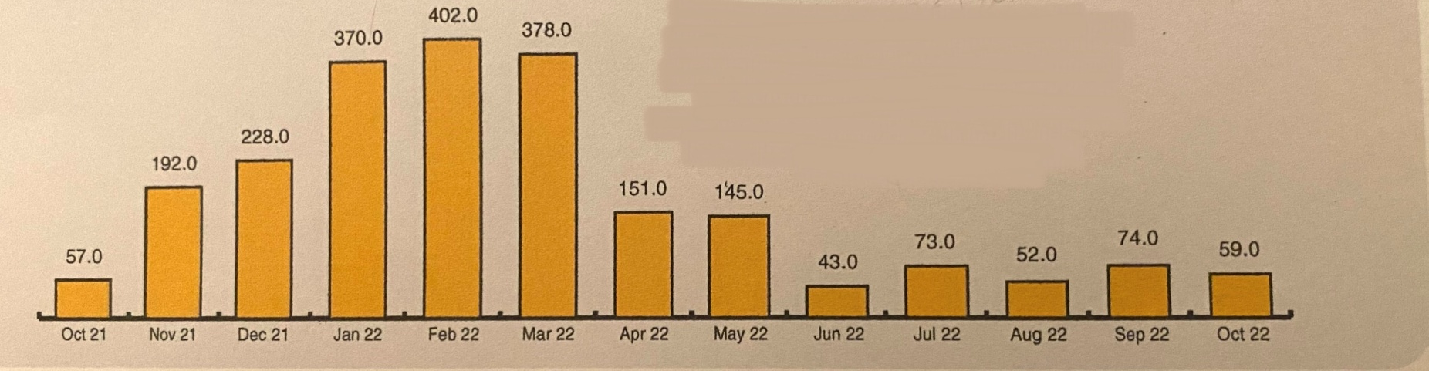
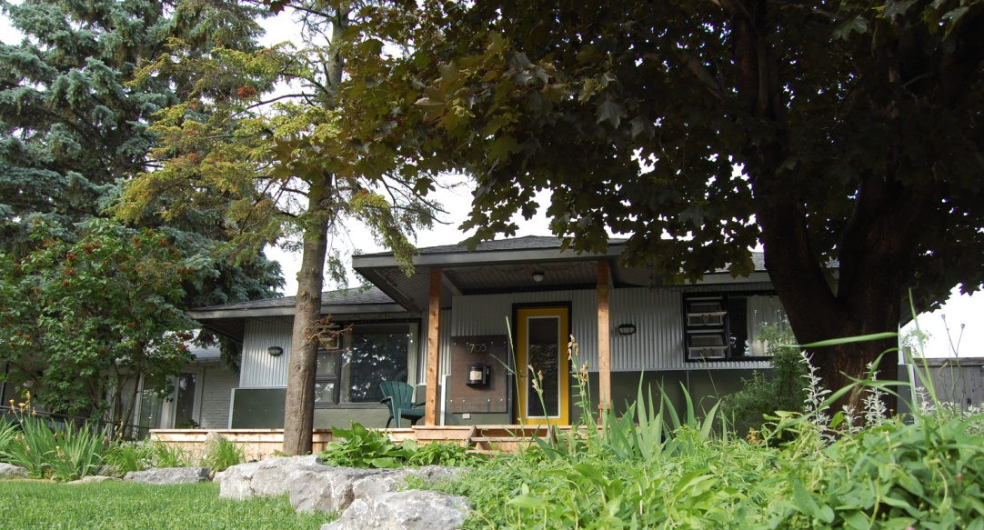
sample
Notes:
If a sample gas bill shows an annual consumption of 2,224 cubic meters of natural gas, that would convert to some 23,500 kilowatt hours of electricity if I could magically convert that overnight. While some of that gas can be, and has, been trimmed by converting to an induction stove and getting rid of the gas dryer or hot water tank, these are small potatoes – that might be 50 to 60 cubic meters in a typical month. That’s thousands of dollars in annual hydro bills.
Spending $15 or 20 thousand dollars to convert a gas furnace to electric furnace, to spend more every month in electricity bills clearly isn’t the solution by itself.
But what if I improved my wall insulation, increased the thermal performance of doors and windows. lets say that the peak current natural gas demand for heating is 400 cubic m of gas, or 4200 kwh in a month. If we can reduce that by 40% with a better envelope, that’s only about 2500 kwh. And if one solar panel can produce 1.8kwh per day, that’s about 54 kwH per month. That means I need about 46 solar panels; if each one is about 2m x 1m, I need about 92 sq m of roof mounted solar panels. That’s a little over 1,000 sq ft, easily accommodated on a typical home.
Suppose I don’t have 92 sq m of roof I can use?
Go back to the three Rs:
What other energy load can I reduce?
Is there another energy source to reuse?
Is there some other source of energy that can be recycled?
Supposed you add a ground source heat pump? What is the power required for the pump? Will the cost of the well, the pump and the infrastructure be traded off against the cost of more insulation to further reduce thermal loss? What if you had an option to drill several ground source heat pumps and share them with your neighbours, splitting the cost among many? Or if your neighbour had excess solar capacity?

Slide 9
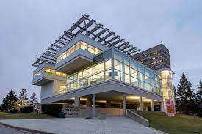
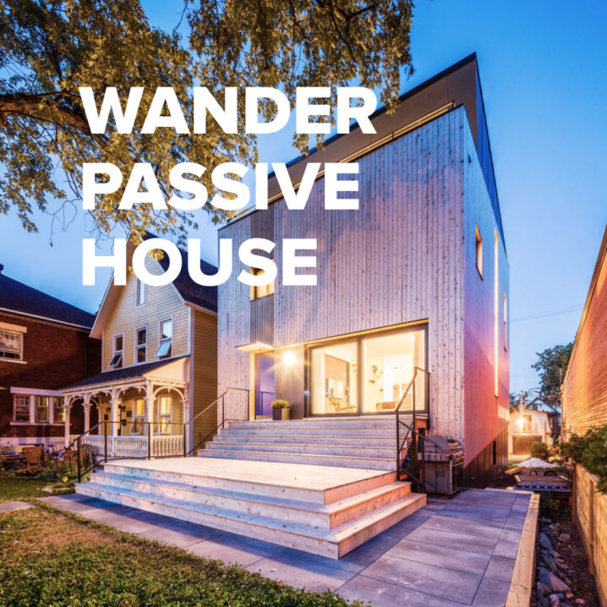
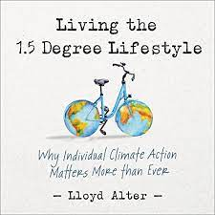
Passive house
Mark Rosen, Build Energy Inc.
www.webuildahome.ca
(poster image from Ottawa Architecture Week 2019)
Notes:
All this leads towards passive house standards. I’d encourage you to check out Lloyd Alter’s book, “Living the 1.5 degree lifestyle”
Passive house standards are a goal: we should be working towards making our buildings better and, as a bonus, we get better social outcomes: healthier environments and better experiences.
Yes, this costs money to do. but the payback is enormous.
On the top right is an image of the OAA headquarters. I was part of the committee during the renovations carried out by David Fujiwara architect on Ruth Cawker’s original building. affectionately, its considered a six sided glass box on stilts. It isn’t really but there is an awful lot of glass, its an irregular shape and it is entirely up on posts so exposed to weather on all sides. At 26,000 sq ft, its not a small building but had utility bills in the six figures; after renovations, the winter hydro bill was about $50 a month at worst. The payback on this renovation was about 17 years based on 2015 utility rates which, if they go up, can be reduced to a payback of less than a decade.

Slide 10

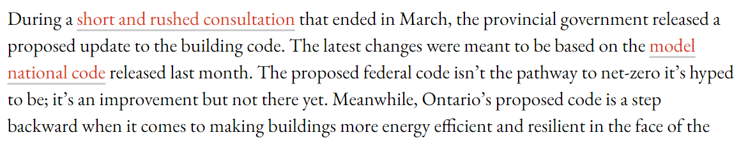
What can I do?
Demand better codes
Advocate for sustainable funding
Design like it matters
Take local action
Build resilience
Notes:
We need to demand better codes:
Remember I said its all connected and that architecture is a political act? In this article from April of this year, Chris Ballard shows how our codes are going backward. At one time, Ontario was a leader and we were, albeit slowly, moving towards a net zero energy code. But no more.
The cost of upgrading insulation, replacing energy sources and improving energy efficiency in our homes is not cheap. It can run to tens of thousands of dollars and its not unrealistic to imagine a six figure cost. Lack of funding choices mean that this is individually financed: we need governments to step up with real funding, as well as banks and insurance companies to create models where more resilient, reliable and energy efficient communities have access to better funding.
We need to design better: we don’t enforce existing codes and standards for durability or resilience and pawn off the lifecycle cost of buildings, suburbs and other infrastructure to future generations. We need to see design not as a commodity, but as an investment that pays off in better, transformative and positive social outcomes.
We need to think of the things we can do locally: can we plant a tree? Can we walk to the grocery store or ride a bike? Can we buy local goods that don’t need to be transported as far? When our windows need to be replaced, can we make them better than before? Can we live in a smaller space, wear a sweater and turn the heat down slightly to reduce our energy needs? When we see an infill project being proposed, can we support it because it means less sprawl, less parking and more neighbours to support our local businesses? When we see a bike lane being proposed, can we support it so that its safer for us or our kids to get to the store, school or work?
Lastly, build for resilience: increasingly extreme weather events, be that worsening cold, more extreme winters, more sever summer storms will test the ability of our grid to provide our homes with power. Making our homes independent of that reliance means we’re able to literally weather the storm. Better thermal resilience means that even if we’re out of power for several days, we lose less heat and can survive winter better. Designing for resilience means we have cross drafts for ventilation and need less air conditioning. Having a resilient community means we can go to the local store, park or community centre to meet our daily needs for food, community and solace.

Slide 11


