Slide 1
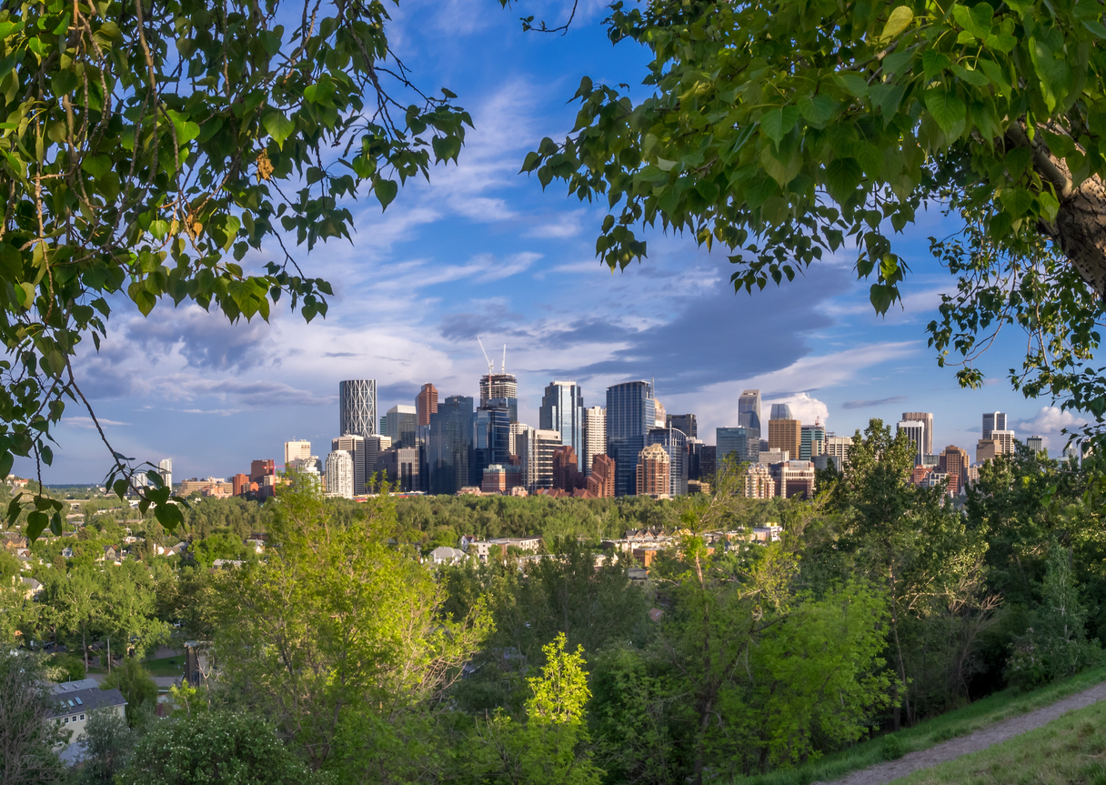
Climate Resilience Panel Discussion: How to start climate proofing your home and community
Notes:
Hello This is a joint event of Centertown and Glebe Community Associations. I am Joan Freeman from Glebe Community Association
The purpose of this panel discussion is to start the conversation in our communities about what we can do to climate proof our homes and communities.
We want you to know that the situation isn’t hopeless. Actions we start soon will make a huge difference. Also, taking action makes you feel better.
I have three messages to set the stage for the discussion.
Message one: Heat is a Big Risk for Our Communities

Slide 2
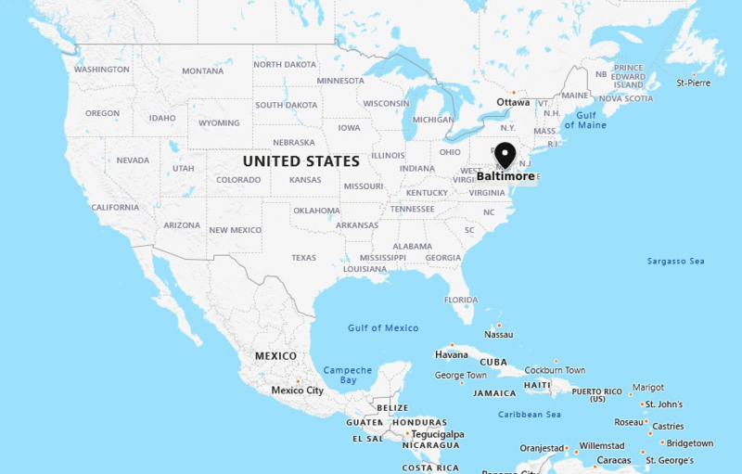
Notes:
We are becoming like Baltimore, and sometimes even Phoenix or the Sahara! Our stable climate is no more. We are getting hotter and also the temperatures will be yo-yoing more – sometimes very hot (like the Sahara) and sometimes cold (like now), but mostly a lot of hot and sticky days like Baltimore.
This is a problem – we are built to be a northern, cold city on the edge of the Boreal. We don’t have nearly enough shade or cooling and too much dark pavement and roofs for a Baltimore climate.
By the middle of the century and probably sooner Ottawa will look and feel like a different place.

Slide 3
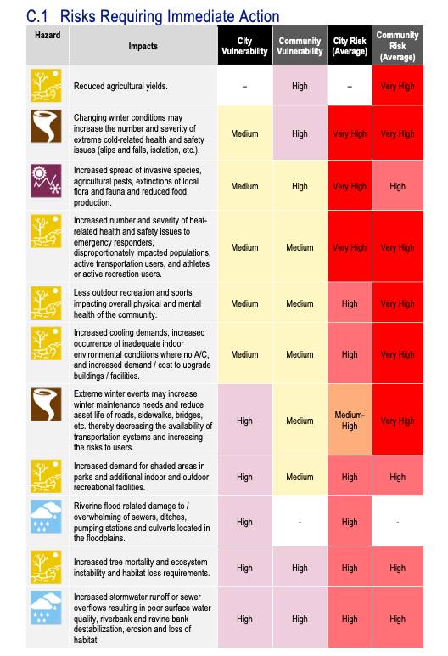
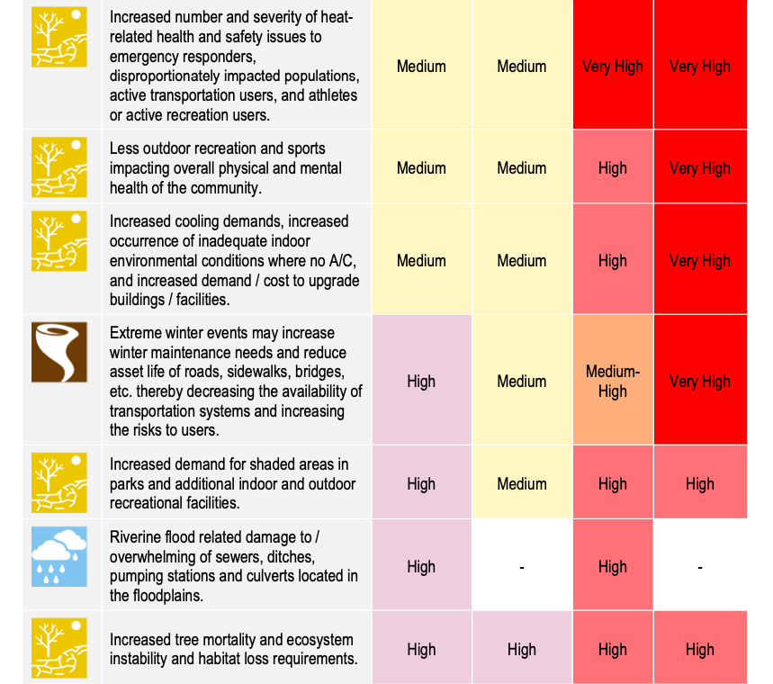
Heat is an urgent risk
Notes:
Heat is a very high risk for the community.
Look at all the red – these are the urgent high priority risks in the city of Ottawa and heat is at the top of the list of 40 priority risks and has the most reds. The heat risks that the community will face are the ones circled. It’s mainly up to us to deal with them.
The city identified
These figures come from a recent City of Ottawa report (June 2022), the Climate Vulnerability and Risk Assessment report. You can find it on the Engage Ottawa website and its worth looking at.
Next turn to Message 2: We need to get started

Slide 4
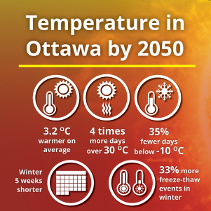
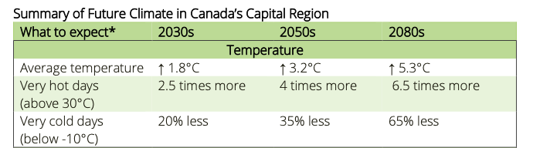
Its getting hot fast
Notes:
Our summers are going to get hot fast. By 2030 we’ll have 2.5 times the number of very hot days (heat warning days) - that’s almost a month (27 days) of hot days in a bit over 7 years from now. By 2050, more than 1/3 of the summer will be very hot (44 days).
This information comes from a 2020 report by the City of Ottawa and NCC that you can find on the Engage Ottawa website. This 2020 report is called Climate Projections for the National Capital Region and its also worth looking at.

Slide 5


We aren’t ready & time is running out
Notes:
Headlines! Insurance industry knows we aren’t prepared and is saying….
The biggest risk and cause of increasing insurance and damage is that most residents and businesses are unaware of the risks, their responsibilities and the actions they can do to protect themselves
If people delay acting, it will cost multiple times the costs of acting now. (climate impacts will cost Canada billions, making life less and less affordable for households as economic growth slows, governments raise taxes to pay for climate disasters, job losses increase, and goods become more expensive due to disrupted supply chains)
A recent estimate is that for every dollar spent now, you will save between $13 -$15.
Finally Third Message: We can do a lot to make our communities resilient
A resilient city has the ability to absorb and recover from future shocks because they are prepared. Here are two pictures of what our resilient neighbourhoods could look like.

Slide 6
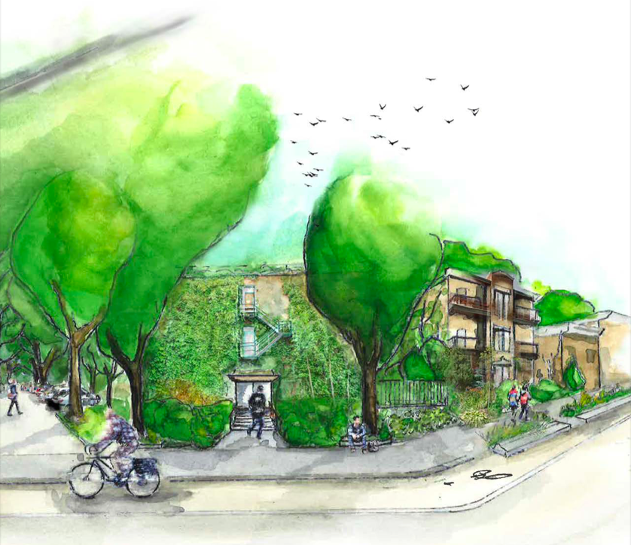
Resilient low rise community
Notes:
What a resilient low rise community would look like in the Glebe or Centertown
From a Health Canada report. Lots of greenery, shade trees, light pavement, and what isn’t shown but talked about are parks, green spaces, cool spaces outside for socializing, sports.
Source: Reducing Urban Heat Islands to Protect Health in Canada. 2020. Health Canada

Slide 7
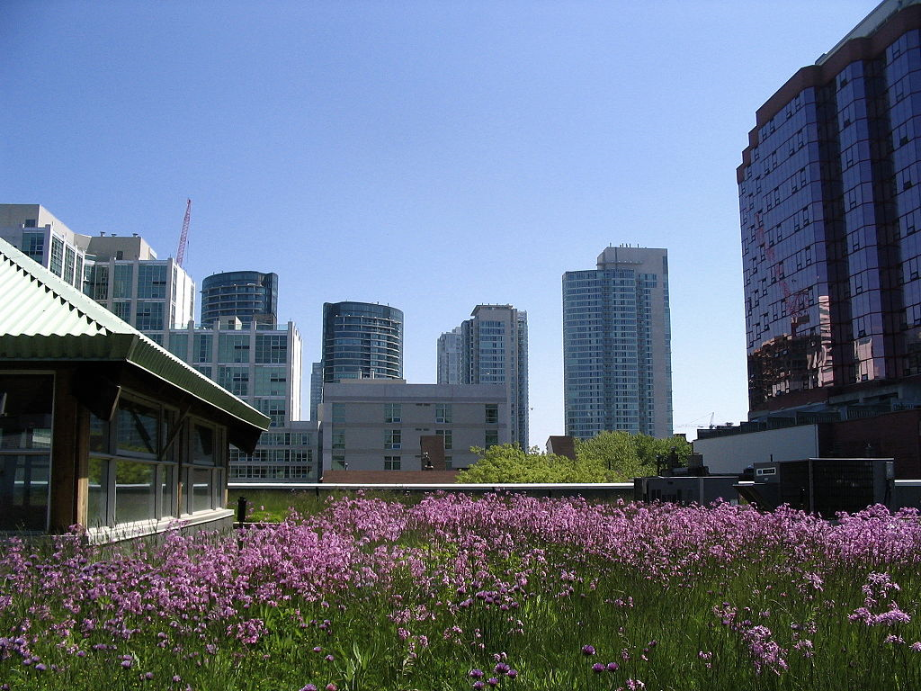
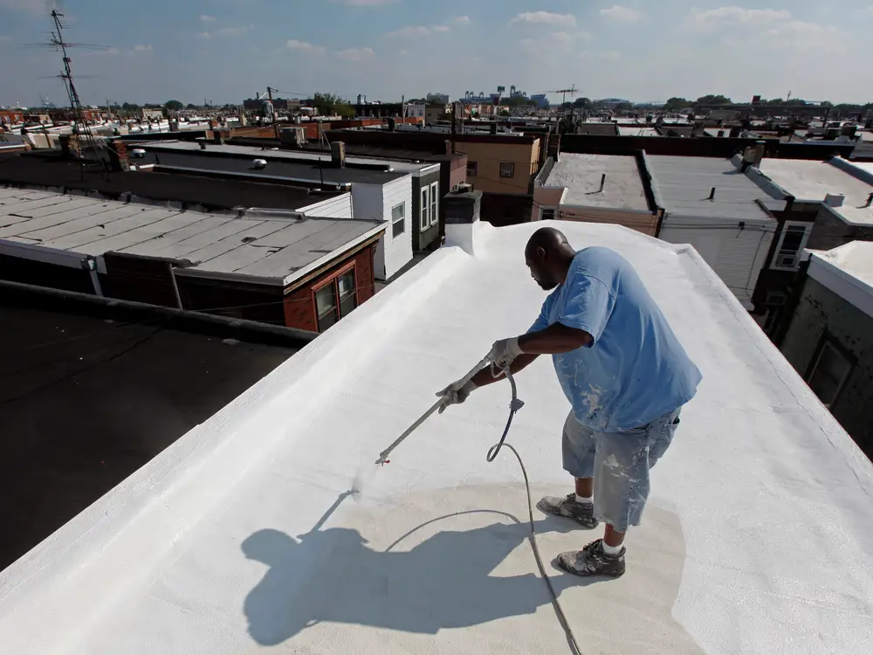

Resilient High Rise Community
Notes:
What a resilient high rise community would look like – similar parks, greenery, trees and cool pavement at the street level but other options
done to cool roofs and buildings. green and white roofs, lots of greenery on balconies and sides of buildings. And different materials.
Sources: 2 of the pictures are from Toronto, 1 from NY. Singapore has been working for years on making its dense high rise communities,
liveable and green. Ottawa can learn a lot from cities like Singapore, New York, LA, Toronto and Vancouver.

Slide 8



What we can do
Look after our Health
Take green actions
Get involved in planning
Notes:
We can do a lot to make our communities resilient … Our speakers today will be talking about our health, greening actions and having a say in how our communities develops.

Slide 9
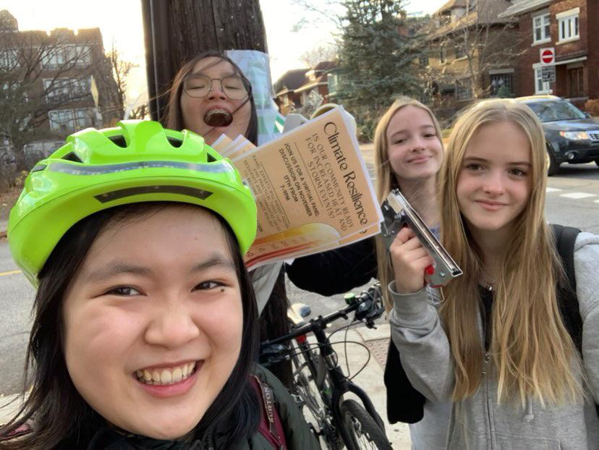
Working together helps
Notes:
Finally, want to say that we will accomplish much more when we work together. And as these smiling students show - its more fun and we will meet our neighbours
We hope this panel discussion is the start of several years of learning and working together.
(Shout out to students from Glebe and Carleton who have helped up prepare for this panel… this is a picture of high school students helping put posters up)

